Slide 1
Predictive Modeling for Auto Insurance Claims
Group 13: Ali Shakiba, Gaurav Sitaula, Rezwan Islam

Slide 2
Predictive Model for Auto Insurance

Slide 3


Slide 4

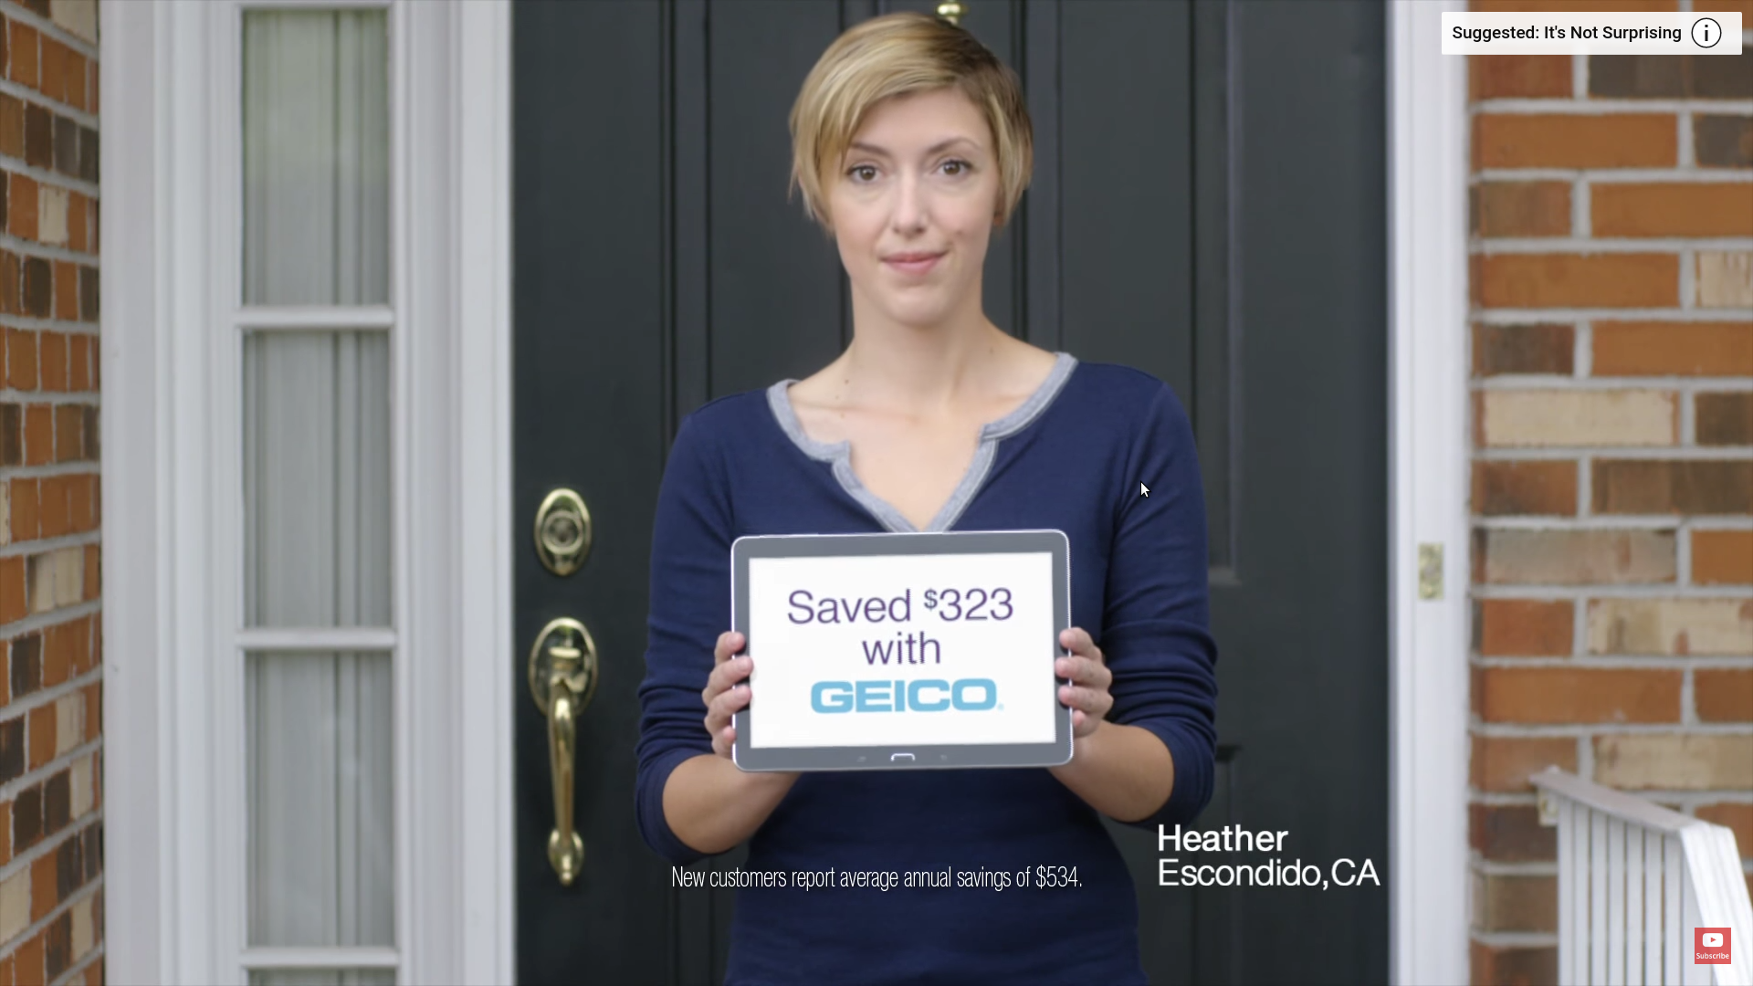
Predictive Modeling Goal: Discount (Money Saved)
“...but what’s not surprising how much money Heather saved by switching to GEICO.”

Slide 5
Predictive Modeling Goal: Target Market
Find and target more profitable markets.

Slide 6
Dataset

Slide 7
Dataset
Customer: Age, Gender, Education Level, Job, Income, Marital Status, House Value
Vehicle: Age, Type, Value
Past Records: Records point, Number of claims(10y), License revoked (10y)
Usage: Urban vs Rural, Commercial vs Personal, Distance to work

Slide 8
Predictive Models

Slide 9
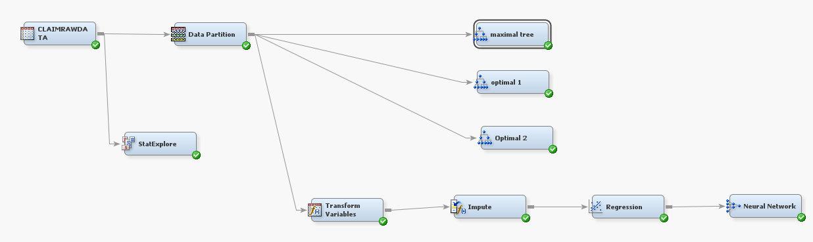
Predictive Models

Slide 10
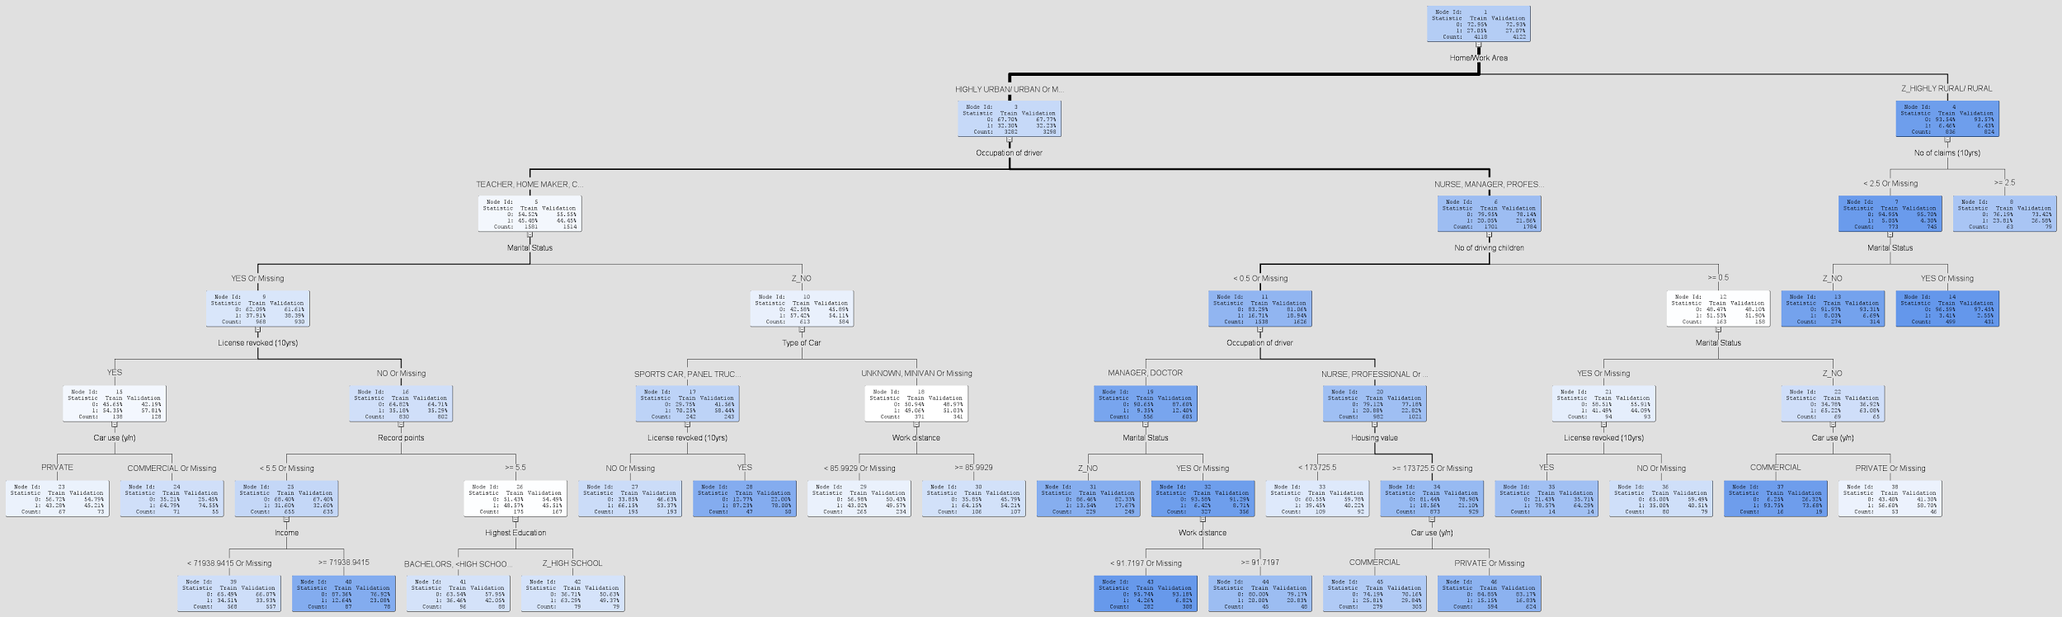
Decision Tree - Maximal Tree

Slide 11
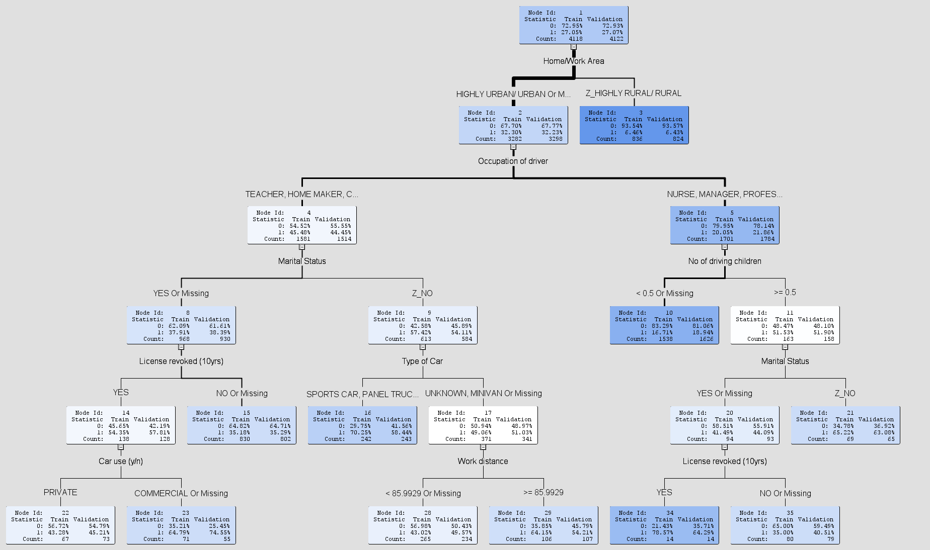
Decision Tree - Optimal Tree

Slide 12
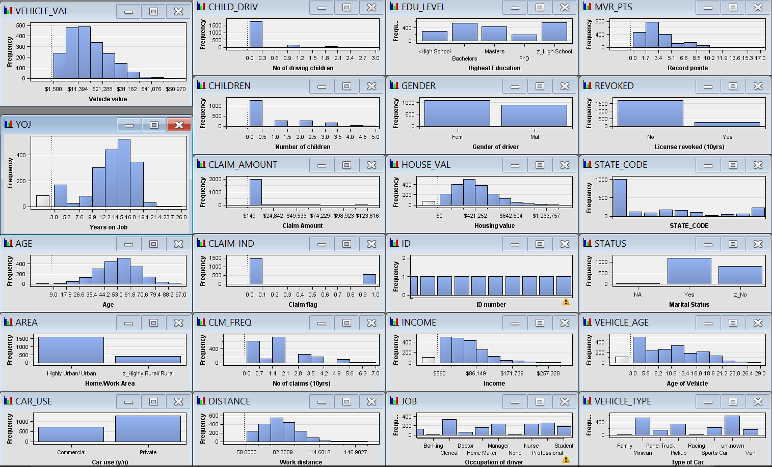
Regression Model - Imputation & Transformation

Slide 13
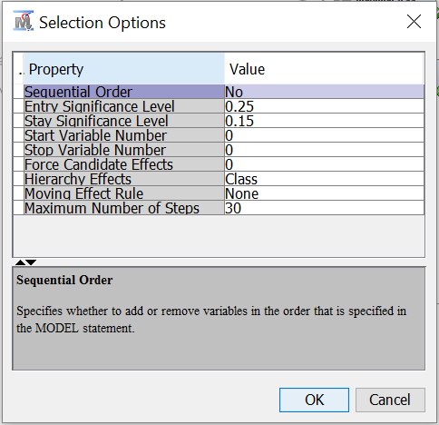
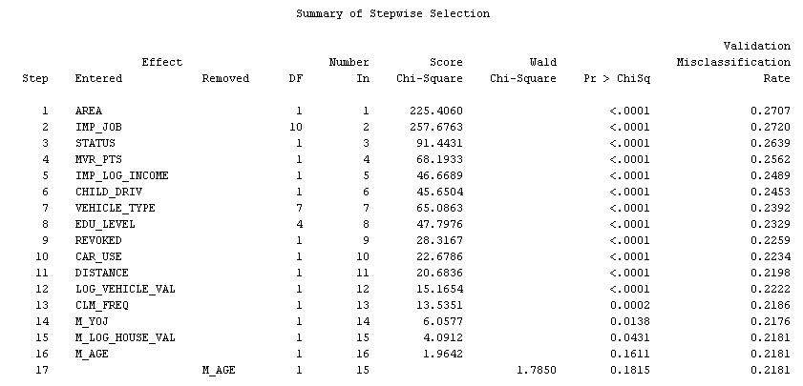
Regression - Variable Selection

Slide 14
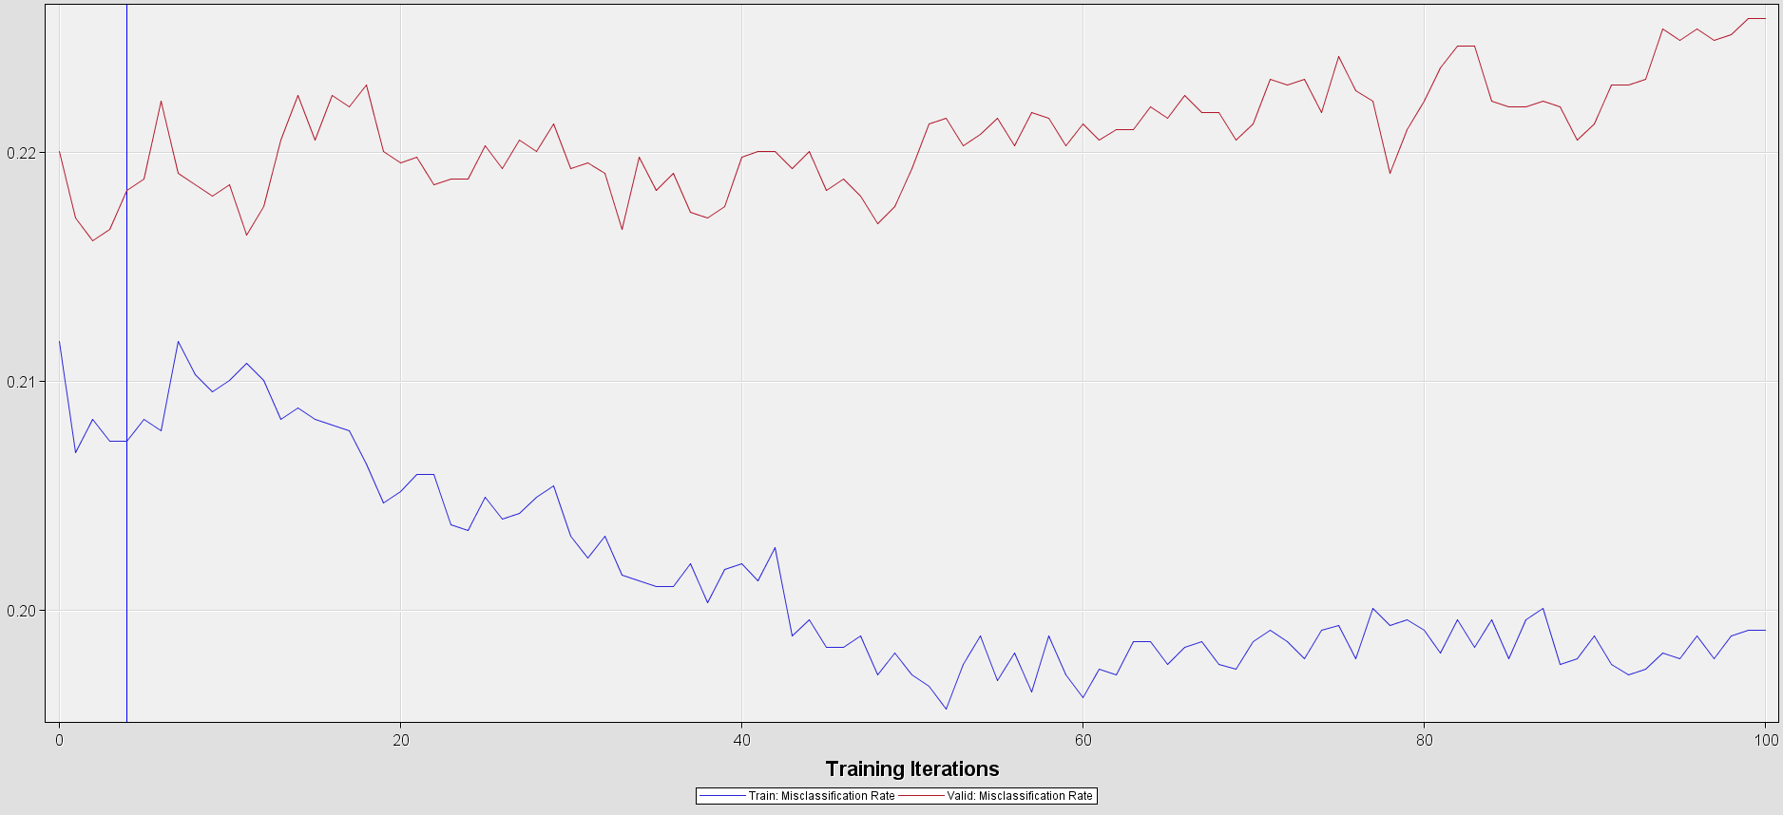
Neural Network

Slide 15
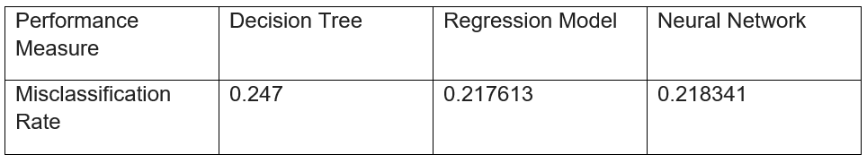
Performance Evaluation:

Slide 16
Results

Slide 17
What to look for?
Usage Intensity and Risk: Urban vs Rural, Commercial vs Personal, Distance to work, Children with Driving License
Past Records: Number of claims, Record points, Revoked License
Customer Info: Married, Have a job (Years on Job), Higher Income
Vehicle: Higher Value, Type

Slide 18
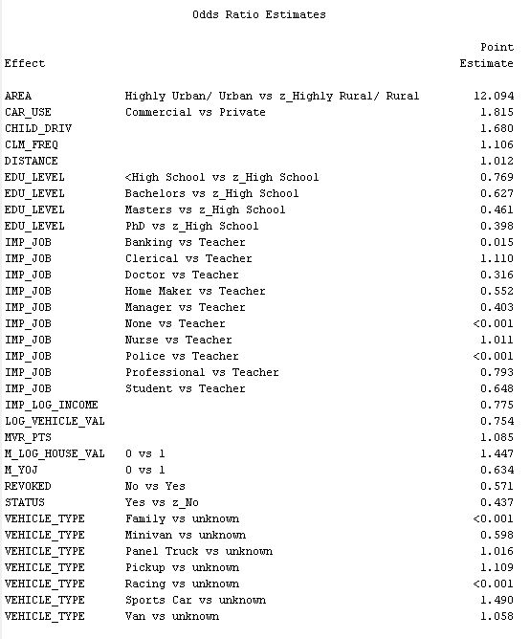
Odds Ratio

Slide 19
Conclusion

Slide 20
Chose your customers wisely, too!

